Slide 1
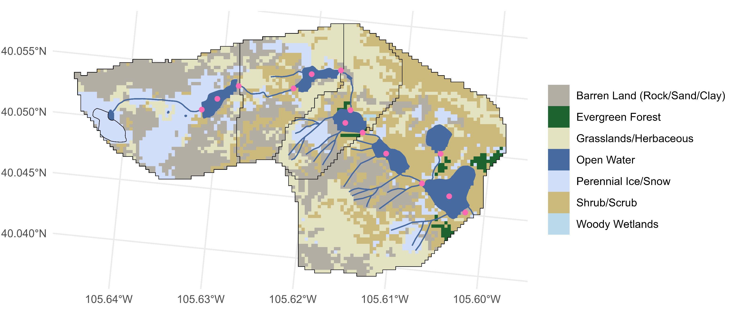
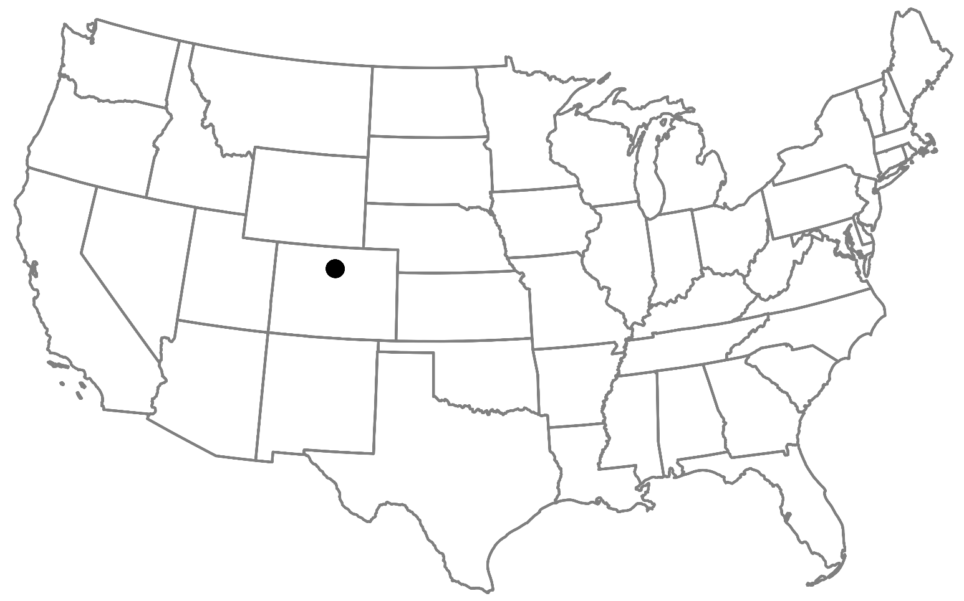
GL4
GL3
Total drainage area: 5.5 km²
Elevation: 3748 m at Arikaree Glacier to 3352 m at Albion outlet
GL5
ALB
27.3%
1.25%
23.8%
Arikaree Glacier
5.17%
14.8%
27.6%
0.07%
Flow direction

Slide 2
GL4
GL3
Total drainage area: 5.5 km²
Elevation: 3748 m at Arikaree Glacier to 3352 m at Albion outlet
GL5
5
6
ALB
3
4
2
27.3%
0
1
7
8
9
1.25%
10
23.8%
0
Arikaree Glacier
5.17%
11
12
14.8%
13
27.6%
0.07%
Flow direction

Slide 3
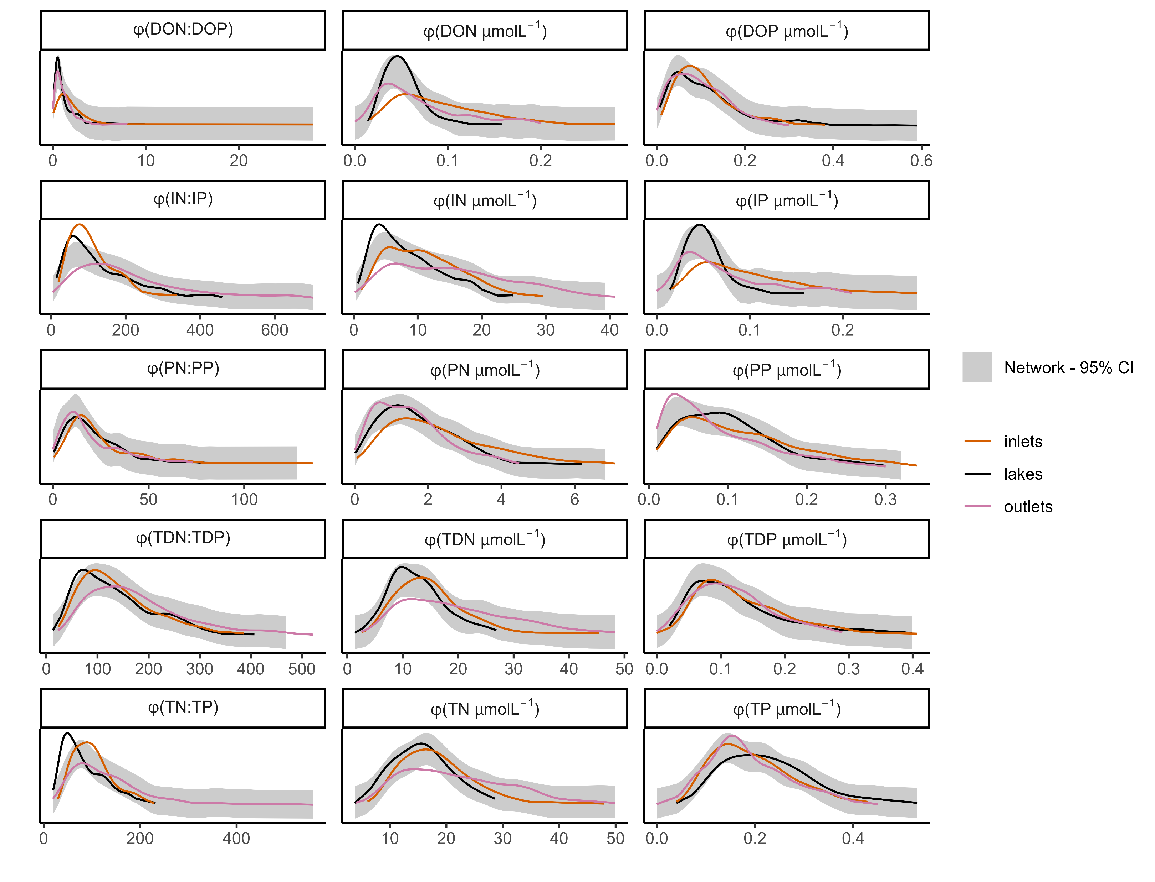
a, b, b
a, b, c
a, b, ab
a, ab, c
a, b, c
a, b, c
a, ab, b
a, b, b
a, a, b
a, a, b
a, b, c
a, a, a
lake and network differ
Stream and network differ
a, b, c
a, b, c
a, b, a

Slide 4
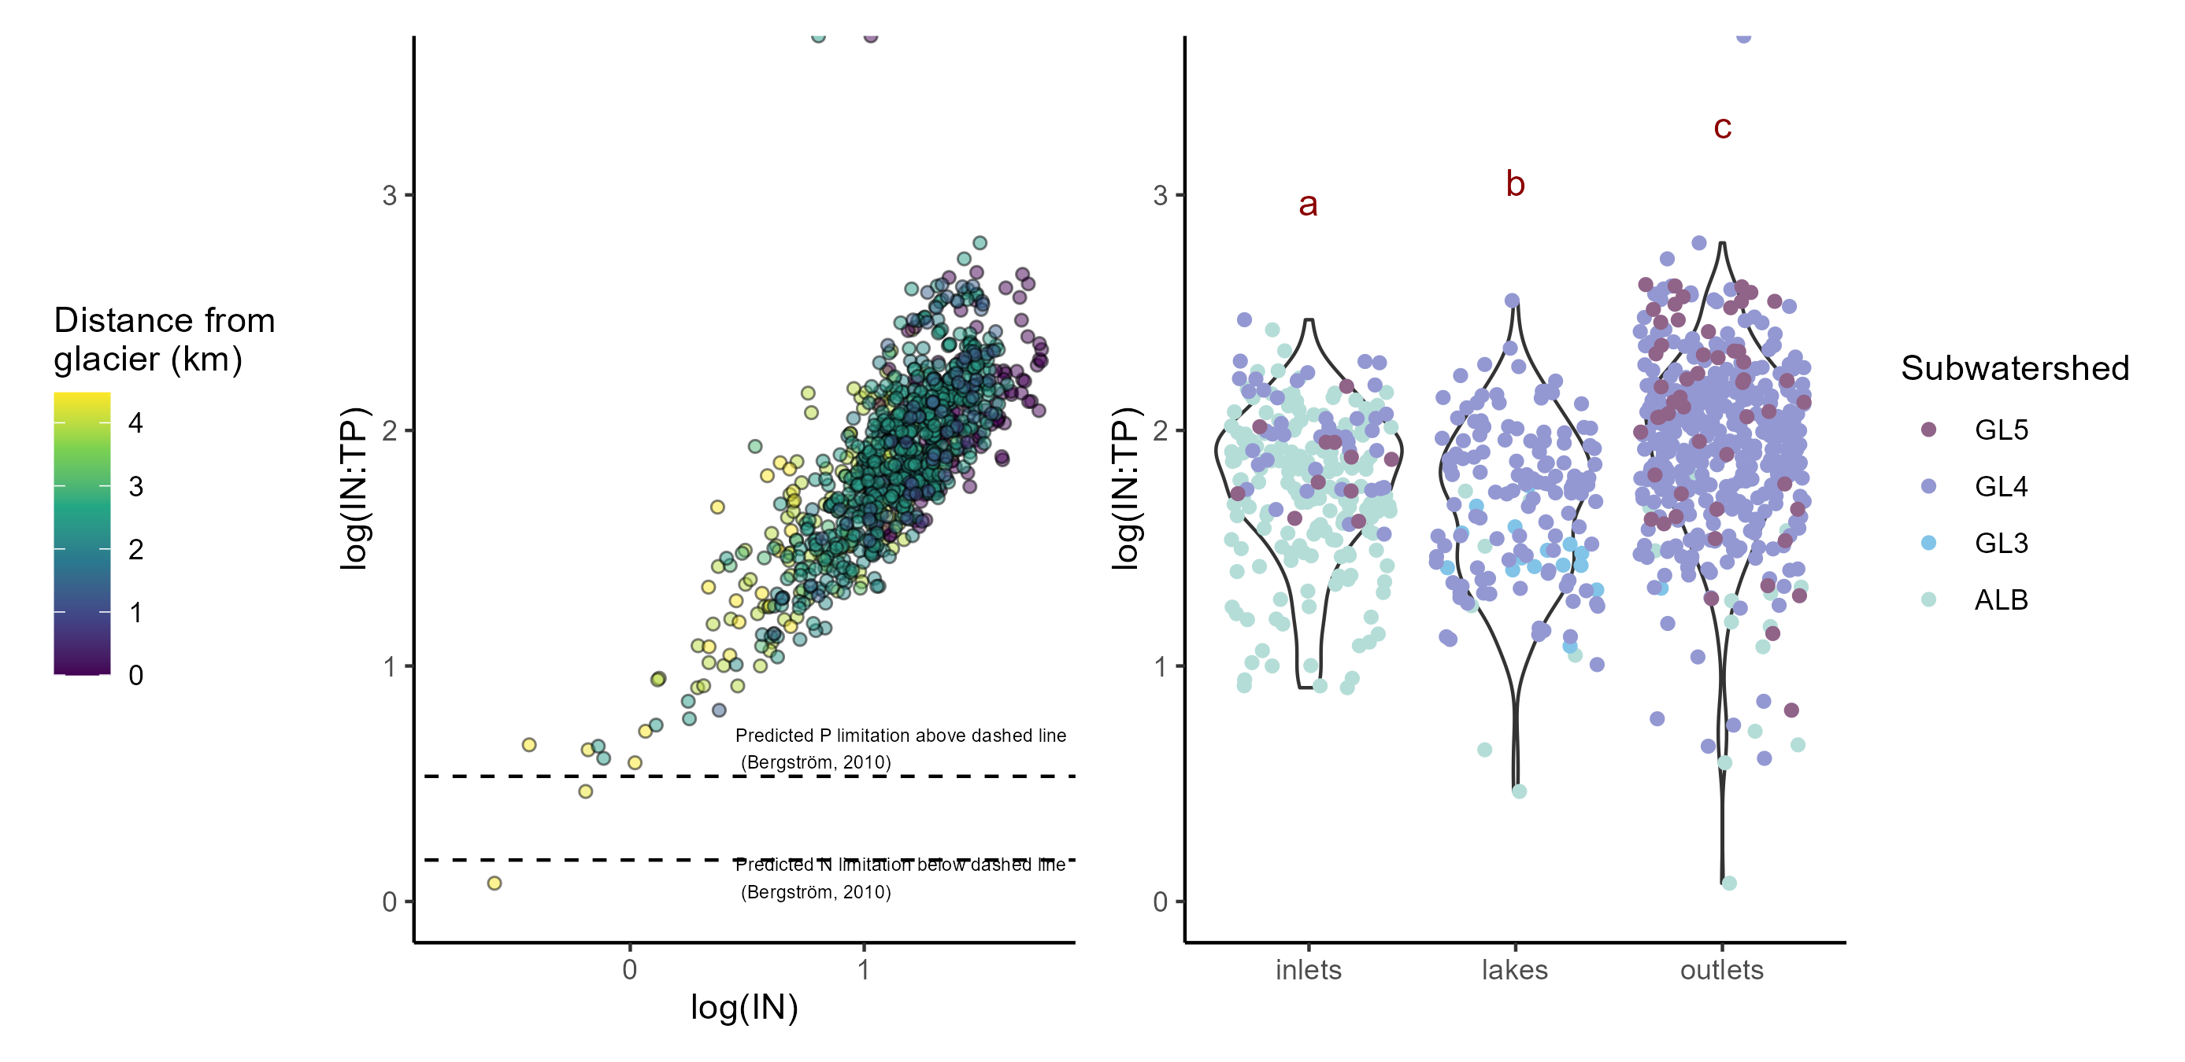
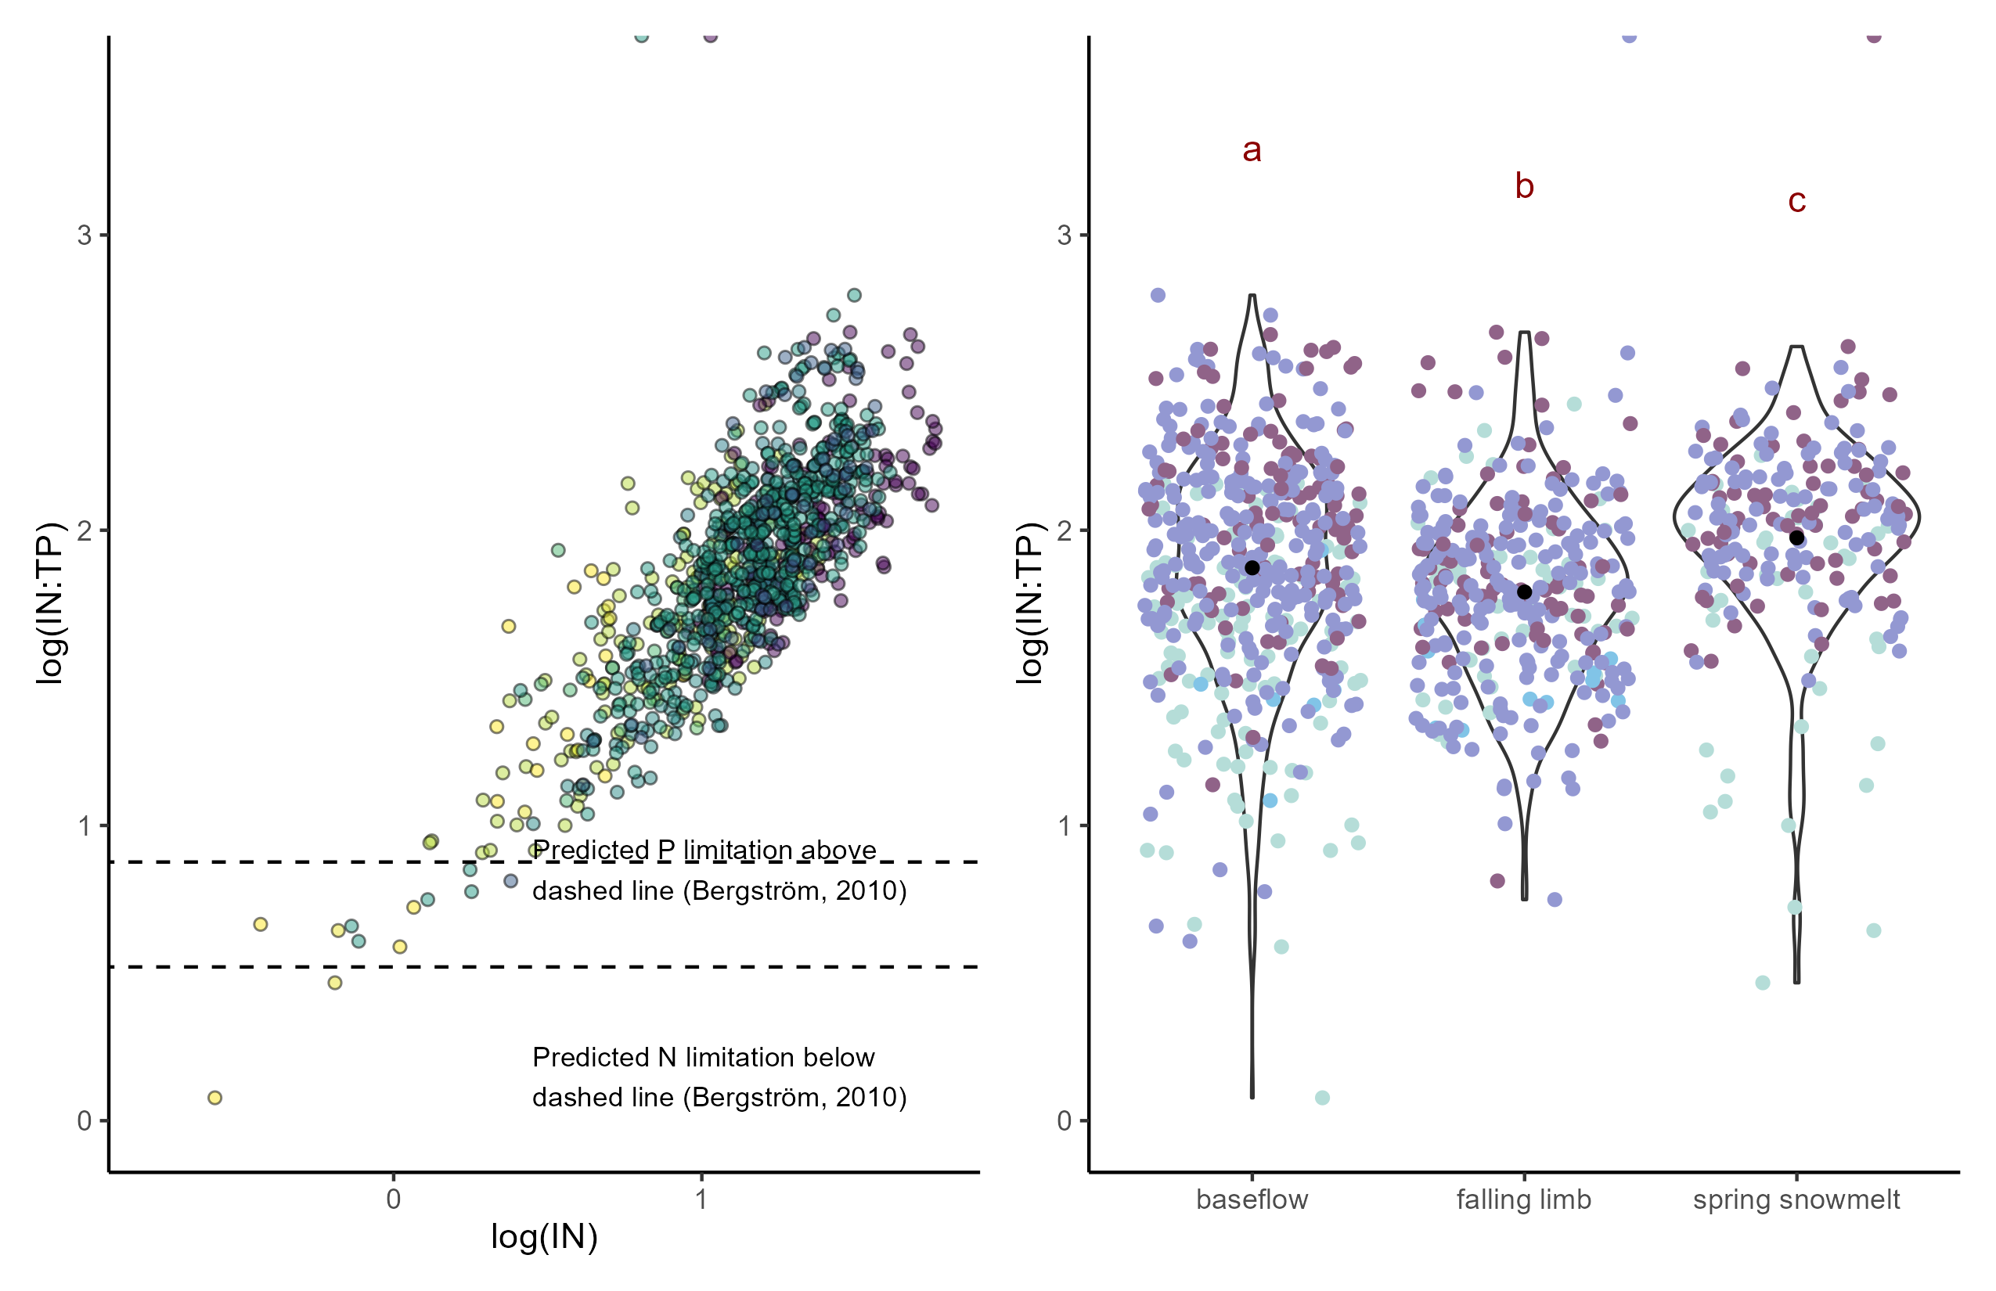
a)
b)

Slide 5
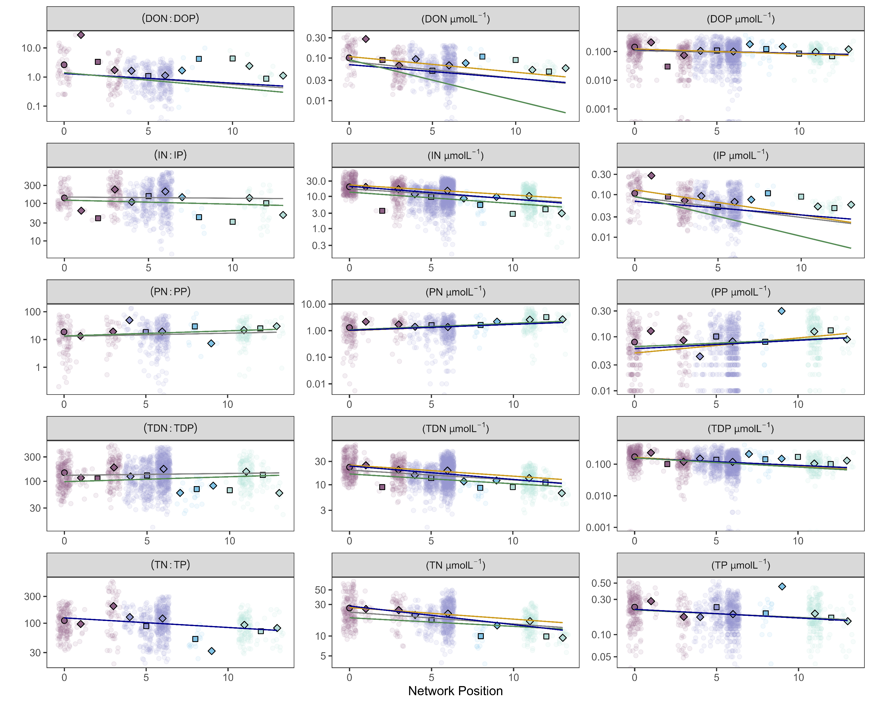
Seasonal slope
global
baseflow
spring snowmelt
falling limb
glacier
lake
stream

Slide 6
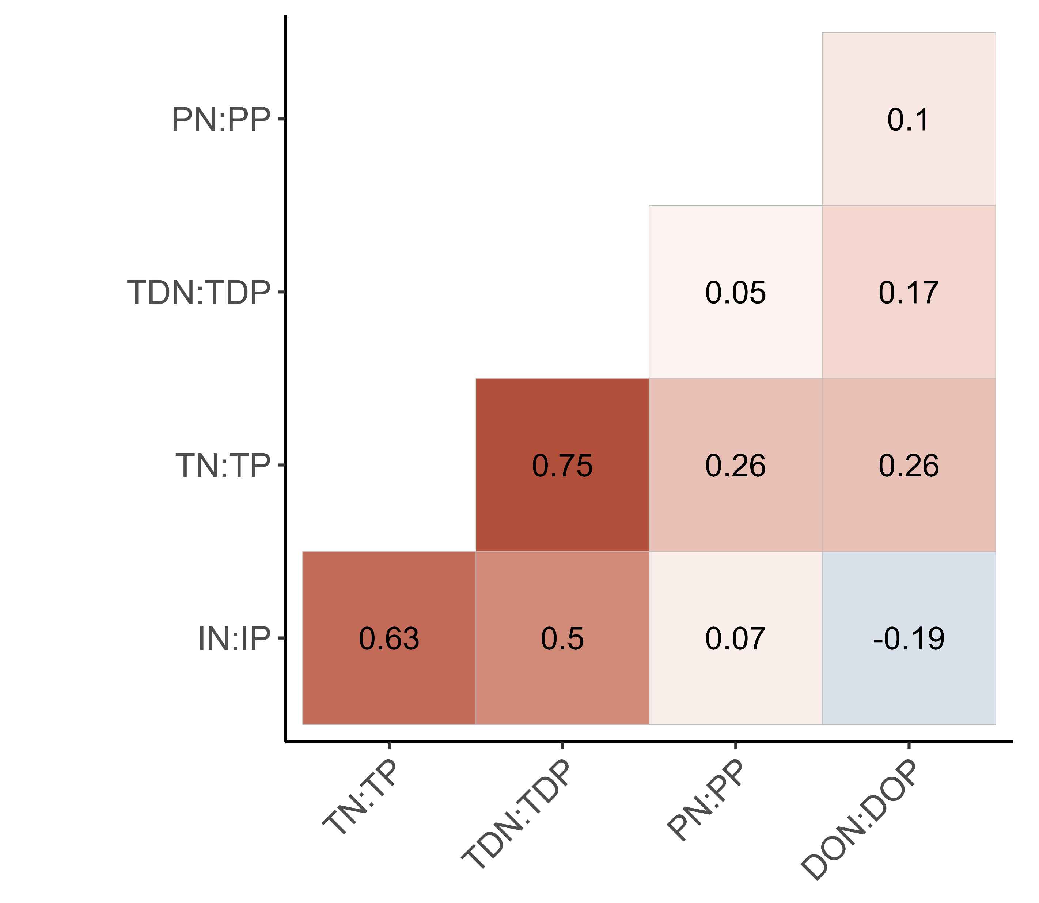
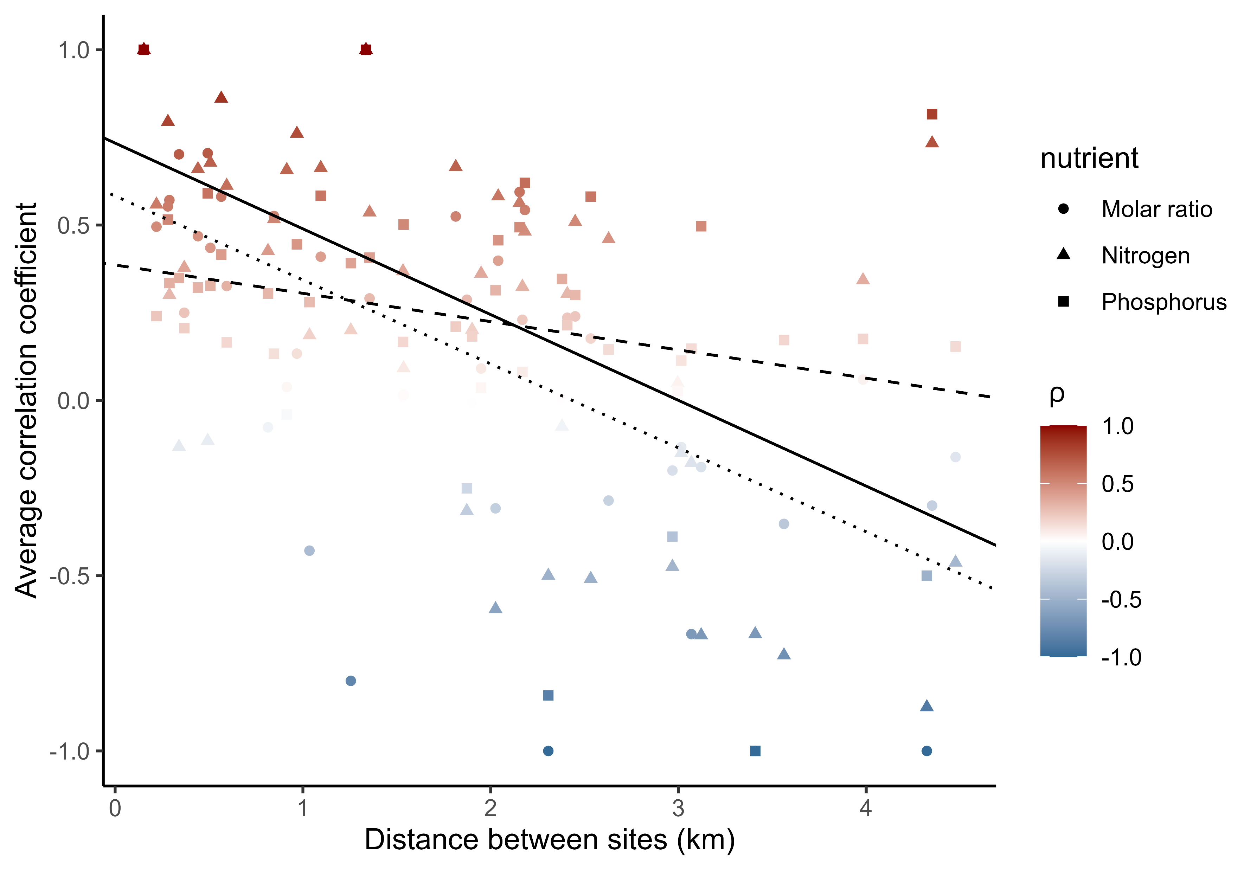
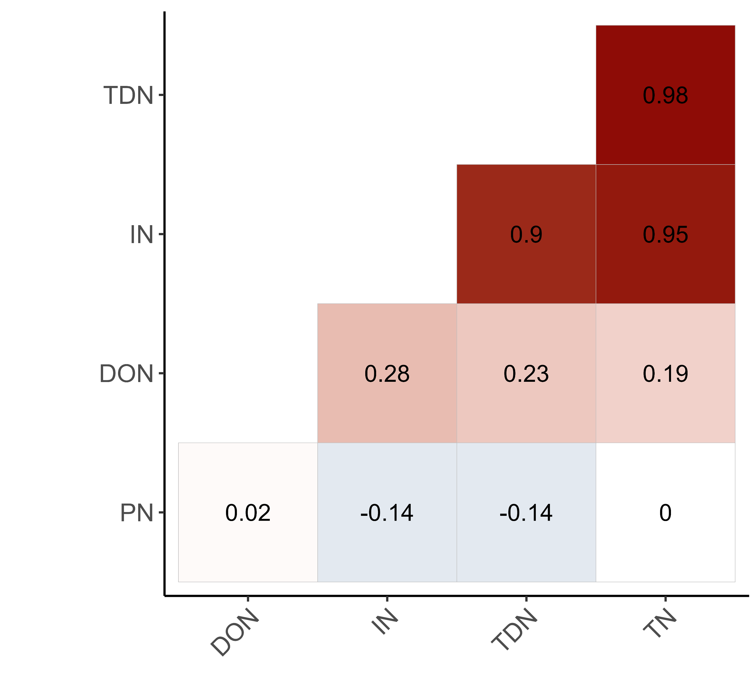
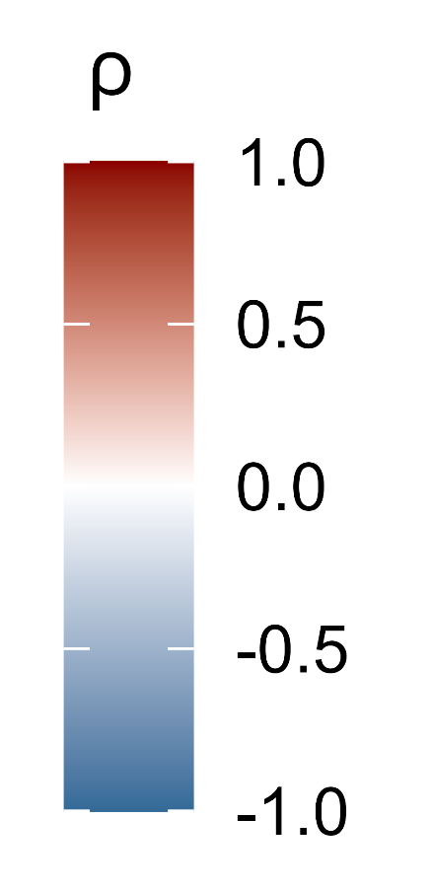
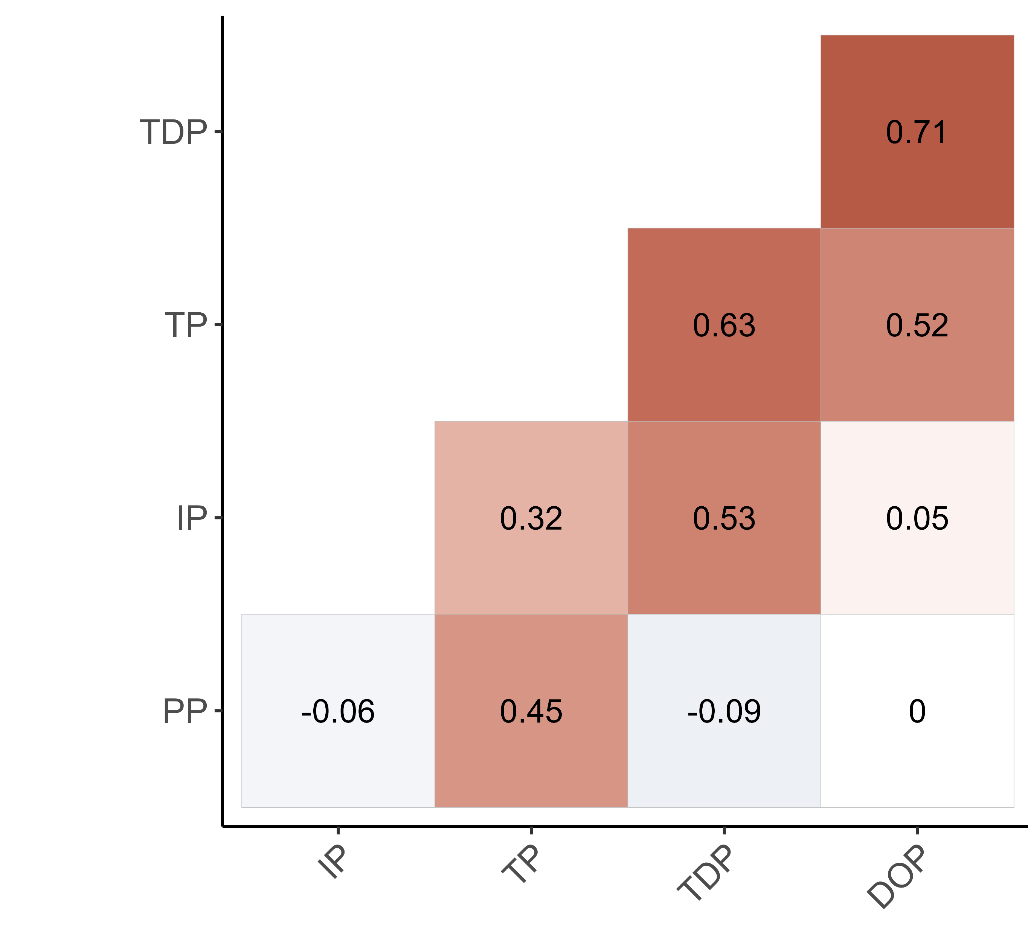
Molar ratio
Nitrogen
Phosphorus

Slide 7
a)
Molar ratio
b)
Nitrogen
Phosphorus

Slide 8
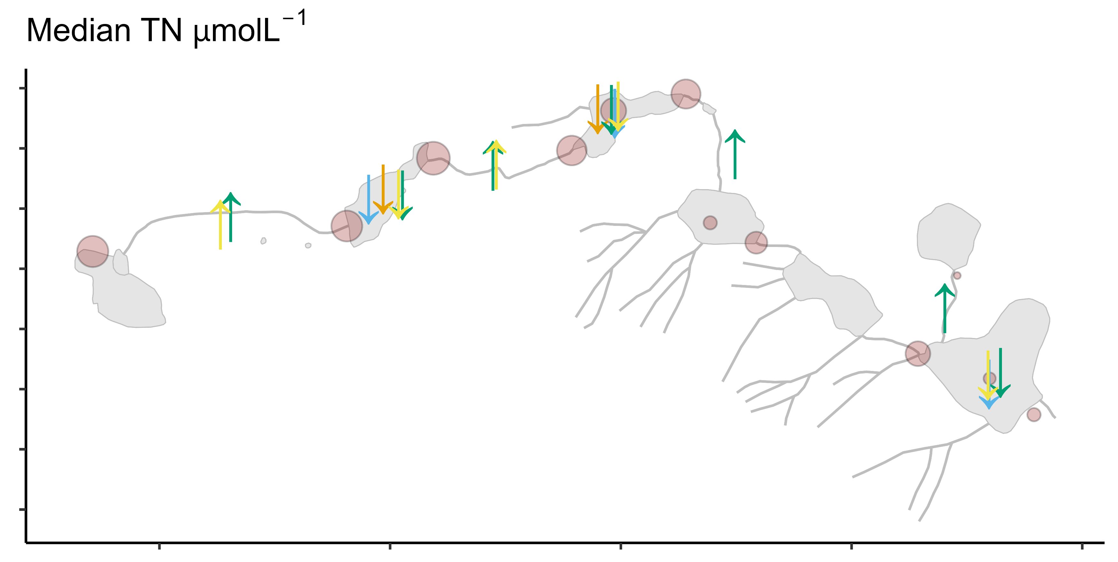
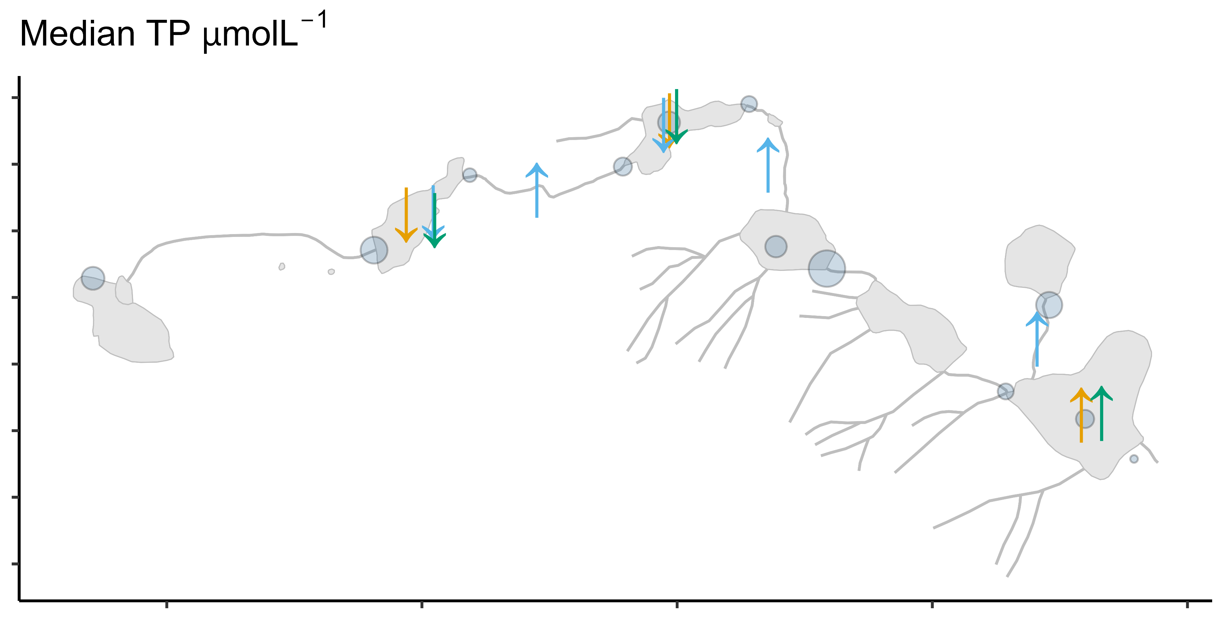
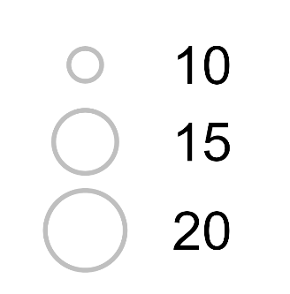
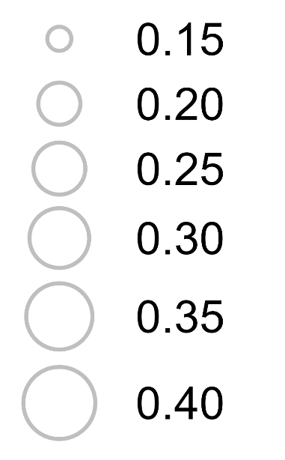
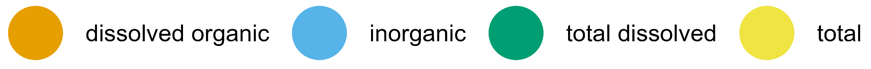

Slide 9
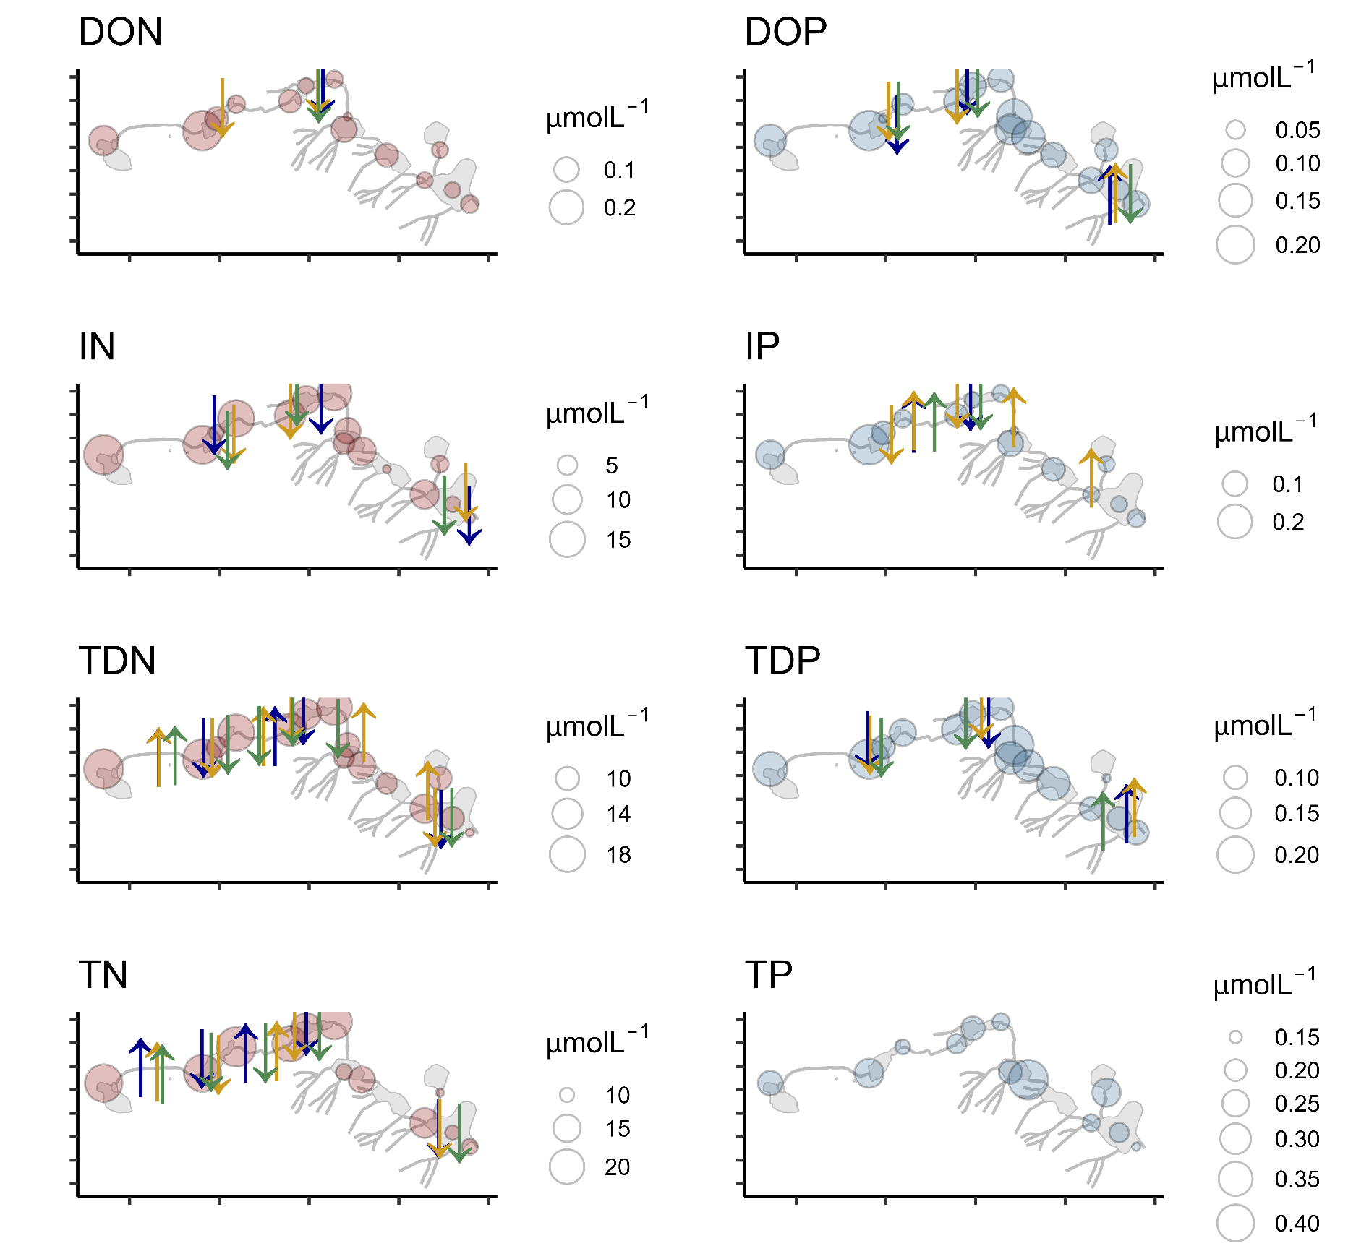
baseflow
spring snowmelt
falling limb

Slide 10
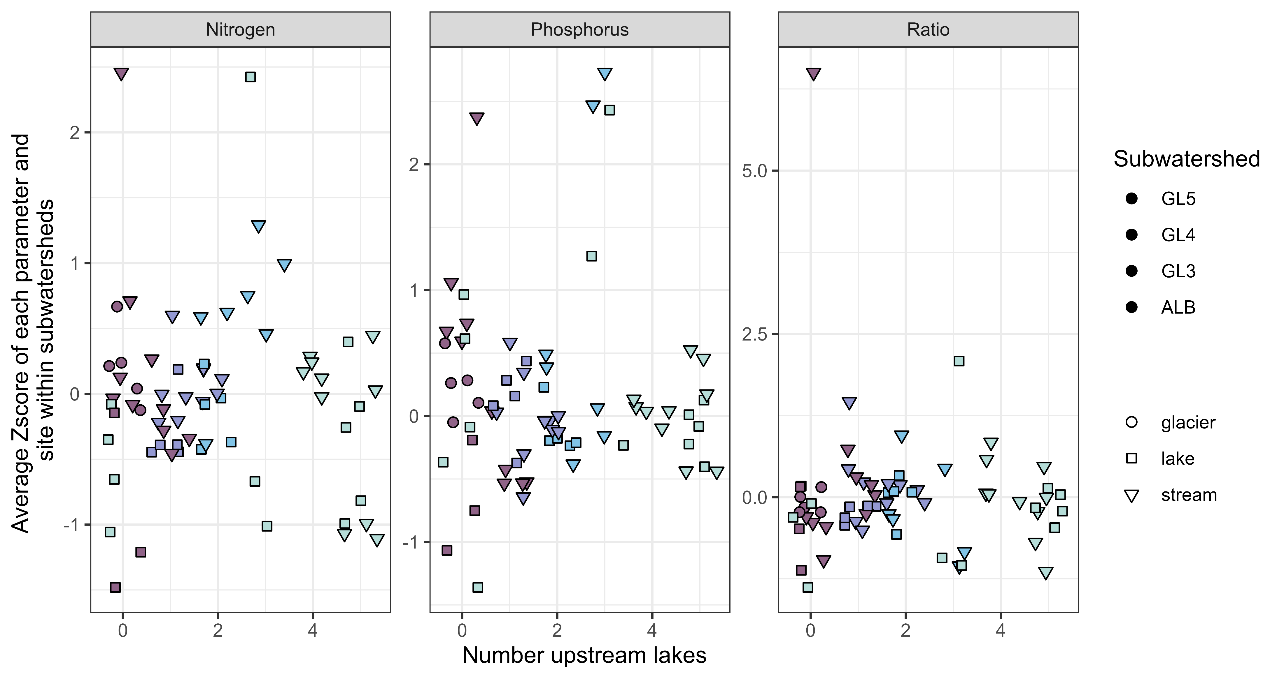


Slide 11
